Slide 1
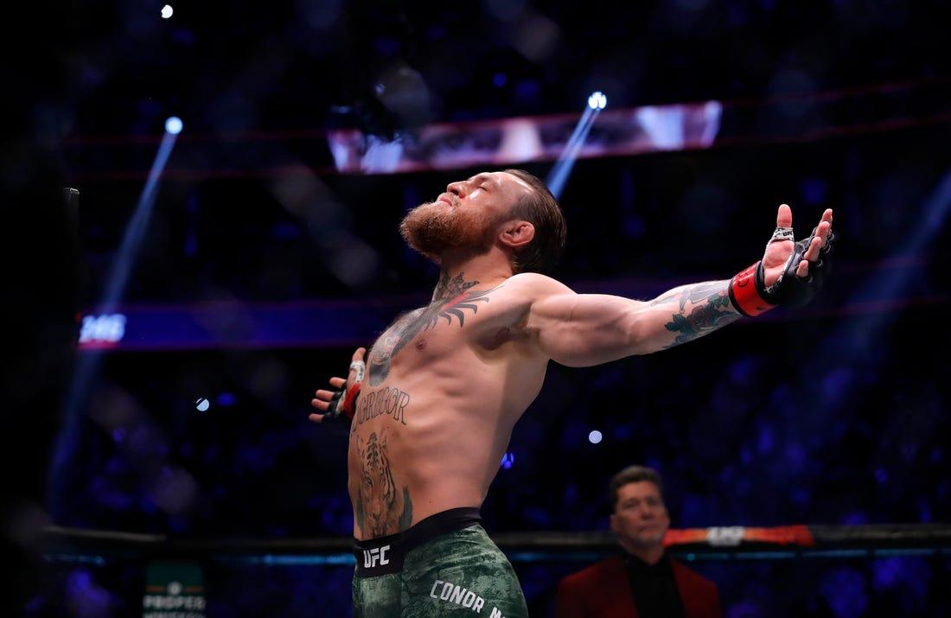
UFC Win-Win Bets
WHERE BETTORS BECOME BILLIONAIRES
ML Powered Betting Website (IST 615-Group 6)
Aditya Tornekar Rishabh Agarwal Shreyas Sadagopan Sourabh Ghosh

Slide 2

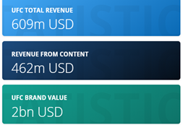
Win-Win Bets : Product Idea
There is no UFC season, year wide events
Has a huge betting population and is fast growing
Barbaric game and thus unpredictable
Simple to understand and hence easy for starters
“Long Run” Model and has an international appeal
Majority of its fan base is between 18-34 years
Only sport which was able to hold its pre-pandemic viewership level

Slide 3
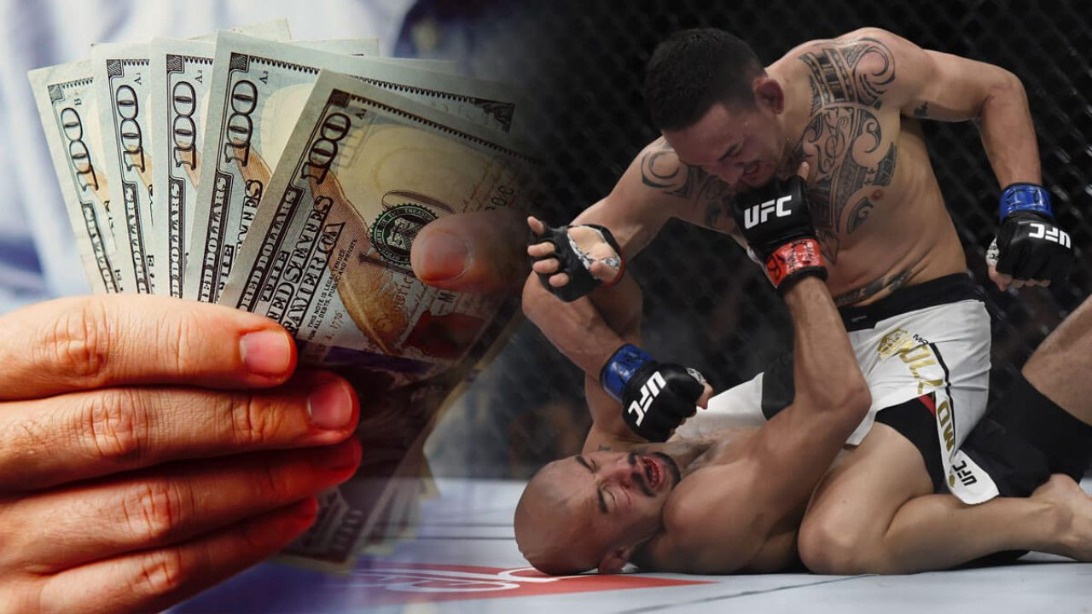

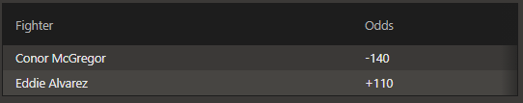
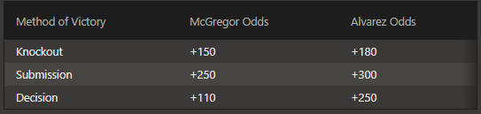
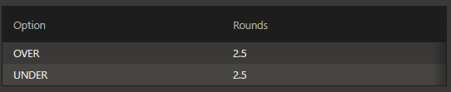
UFC Bets
Decimal Bets
Type of Bets Moneyline Method of victory Total Rounds

Slide 4

BUSINESS STRUCTURE
Leverage the highly unpredictable nature of the sport
Algorithmic manipulation of the Odds using fight analytics
Knowledge of the winner of a brawl with the information of the fighters and their prior records.
Give ‘THE BEST’ available odds evaluation and wagers for the users
Better ODDS/Wager rates - More users - More profit
Using AI Powered Marketing and User Behaviour Analytics to gain the edge over the competitors
Hosted on the Cloud to support ubiquitous and synchronous usage
Advertising and 3rd party funding
Low Entry prices - To attract low profile users
Invent, Strategize and Monopolize

Slide 5
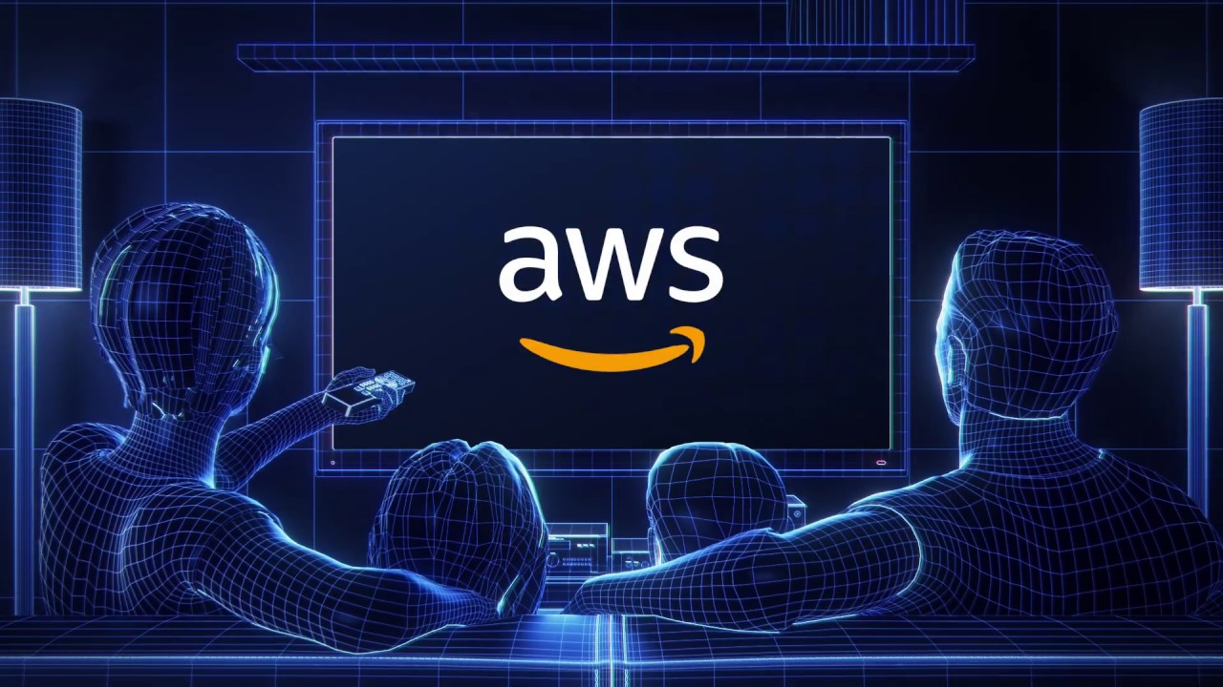
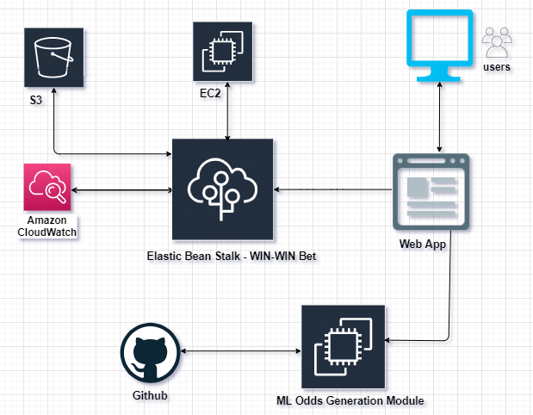
Technology Stack - AWS Architecture

Slide 6






Implementation Architecture
Elastic Beanstalk : Used for deployment and scaling of the Win-Win Bet application
EC2 : Holds the odds generation and winner prediction algorithm integrated with web app interface
CloudWatch : CloudWatch collects monitoring and operational data in the form of logs, metrics, and events, providing you with a unified view of AWS resources, applications, and services
S3 bucket : All user and fight data will be temporarily stored in S3
Github : Code repository for the project

Slide 7

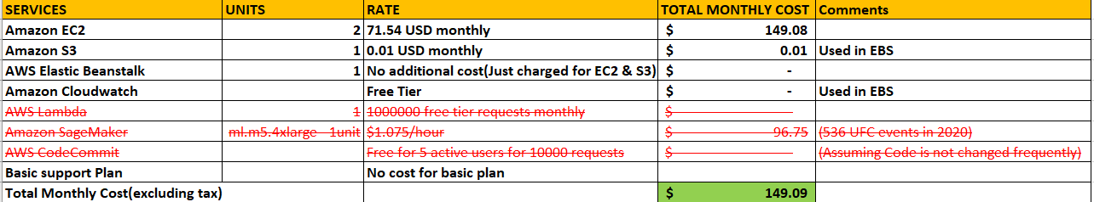
Cloud Cost Model
Infrastructure setup: $149.09*12 = $1789.08
License Cost: Upto $16500 (License to be obtained from the Malta Gaming Authority (MGA)
Marketing Cost: Initially social media platforms will be used(15% of revenue)
Customer Service & Employee cost: 4 * $10,000
Initial in-hand working capital: $50,000
Lawyer and other unanticipated legal fees: $10,000

Slide 8

Business Revenue Model : Freemium
Users :
Free Users
Premium Users
Revenue Streams :
Bets by customers
Margins : Odds Algorithmic Tweaking
Revenue through per bet cuts or ‘juice’’
Customer Engagement : User Behavior Analytics
Revenue from premium account subscriptions
Revenue through ads on the website and fan blogs (other media content)

Slide 9

Scope
Building the Machine Learning Model on the cloud
Fight By Fight automated predictions
Fight analytics dashboard to engage users
Setting the optimal odds using the prediction
Initial Objective : Moneyline Bets
Future Scope
Expand the functionality for round bets and method of victory bets
Scale the application container using kubernetes with respect to predicted user volume

Slide 10

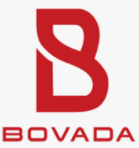


Competitor Analysis
Competitors
MyBookie
Bovada Sports
SportsBetting.ag
BetOnline Sports
Xbet
Our USP:
Mentioned competitors have rollover requirement which our company is relaxing for the user
These websites host multiple sports for online betting, what make us different is exclusivity to UFC sport

Slide 11

Addressing Legal Concerns
Company would be filing for a license in Malta therefore wouldn’t be subjective to follow US laws but would also strive to follow the regulatory norms set by the Malta Gaming Authority (MGA)
At the same time, states have their own laws against specific types of gambling, which include online gambling. To eliminate any issues, we will not be accepting players from Delaware, Maryland, Nevada, New Jersey, or New York
Malta was the first jurisdiction within the EU to regulate online gambling on its shores. Malta has now evolved to become one of the most popular and largest jurisdictions for gambling websites seeking licenses
The biggest advantage of procuring a license from Malta is that it appears on the ‘white list’ issued by the United Kingdom Gambling Commission. This allows Maltese Gaming License holders to exclusively market their services to UK residents. The competitive licensing fees and favourable tax rates in the country are additional benefits
The application fees for a new license in Malta is £ 2230 ($2962) , while the annual fee to maintain the license is £8500 ($11,285), while the renewal fee is £1500 ($1990) per year

Slide 12

Future Goals and Expectations
To scale and spread the application on different regions based on user demand
To filter functionalities for users and admin for placing bets and evaluation of odds
Deploy serverless ML model deployed on sagemaker and Lambda components
AI powered marketing based on user behaviour analytics
Expand the functionality for round bets and method of victory bet

Slide 13
Addressing Legal Concerns
The application fees for a new license in Malta is £ 2230 , while the annual fee to maintain the license is £8500/ The renewal fee is £1500 per year.
There are 4 main kinds of licenses that operators can apply for in Malta :
• Class 1, covering casino-type games, skill games, and online lotteries.
• Class 2, covering fixed odds betting, pool betting, and spread betting.
• Class 3, covering peer to peer gaming and betting exchanges.
• Class 4, which is for software vendors.
Operators can also apply for multiple licenses, which are usually issued for 5 years at a time. The Malta Gaming Authority (MGA) is the organization responsible for regulating online gambling in the region. More than 500 top gambling sites are currently licensed by this organization. The Malta Remote Gaming Council (MRGC) was initiated by the MGA in 2005 to provide licensed operators with a platform to discuss industry developments with the authorities. Giving and receiving feedback is an important aspect of the industry.

Slide 14
License Application Process
Application Process
The application for a license in Malta is processed by the Malta Gaming Authority, and has to go through 4 main stages which the authority uses to thoroughly analyze each case.
Fit And Proper : The MGA does a thorough analysis of each applicant, accessing all possible information related to the company’s personnel involved in the the financial aspect of the firm. The business viability of the prospective licensee is also analyzed.
Business Planning : The MGA critically examines the business plan of each applicant, with an in-depth financial analysis being the norm. The applicant is required to include their marketing strategies, growth targets and detailed HR plan as part of a forecast for their operations.
Operational Requirements : The applicant is also examined based on the instruments which is required to conduct their operations. These instruments include the casino games, softwares, and the business processes as well as rules and terms related to conducting those remote games and control systems.
System Review : After the successful completion of all the 3 stages, the MGA informs the applicant that their application was successful. The applicant is then invited to implement their business in a stimulated technical environment for 60 days, in preparation to launch it properly after that. Within those 60 days, the MGA conduct audits and reviews of the system to eliminate any flaws.

Slide 15
Thank you!

